Slide 1

BMI PREDICTION (Final Project)
By
AJAY KARTHICK M
(EBEON0322581220)
(Batch : 2021-7234)

Slide 2

Contents
Introduction about BMI
Problem Statements
Machine learning
Classification Algorithms
Test and Evaluate Models
Conclusion

Slide 3
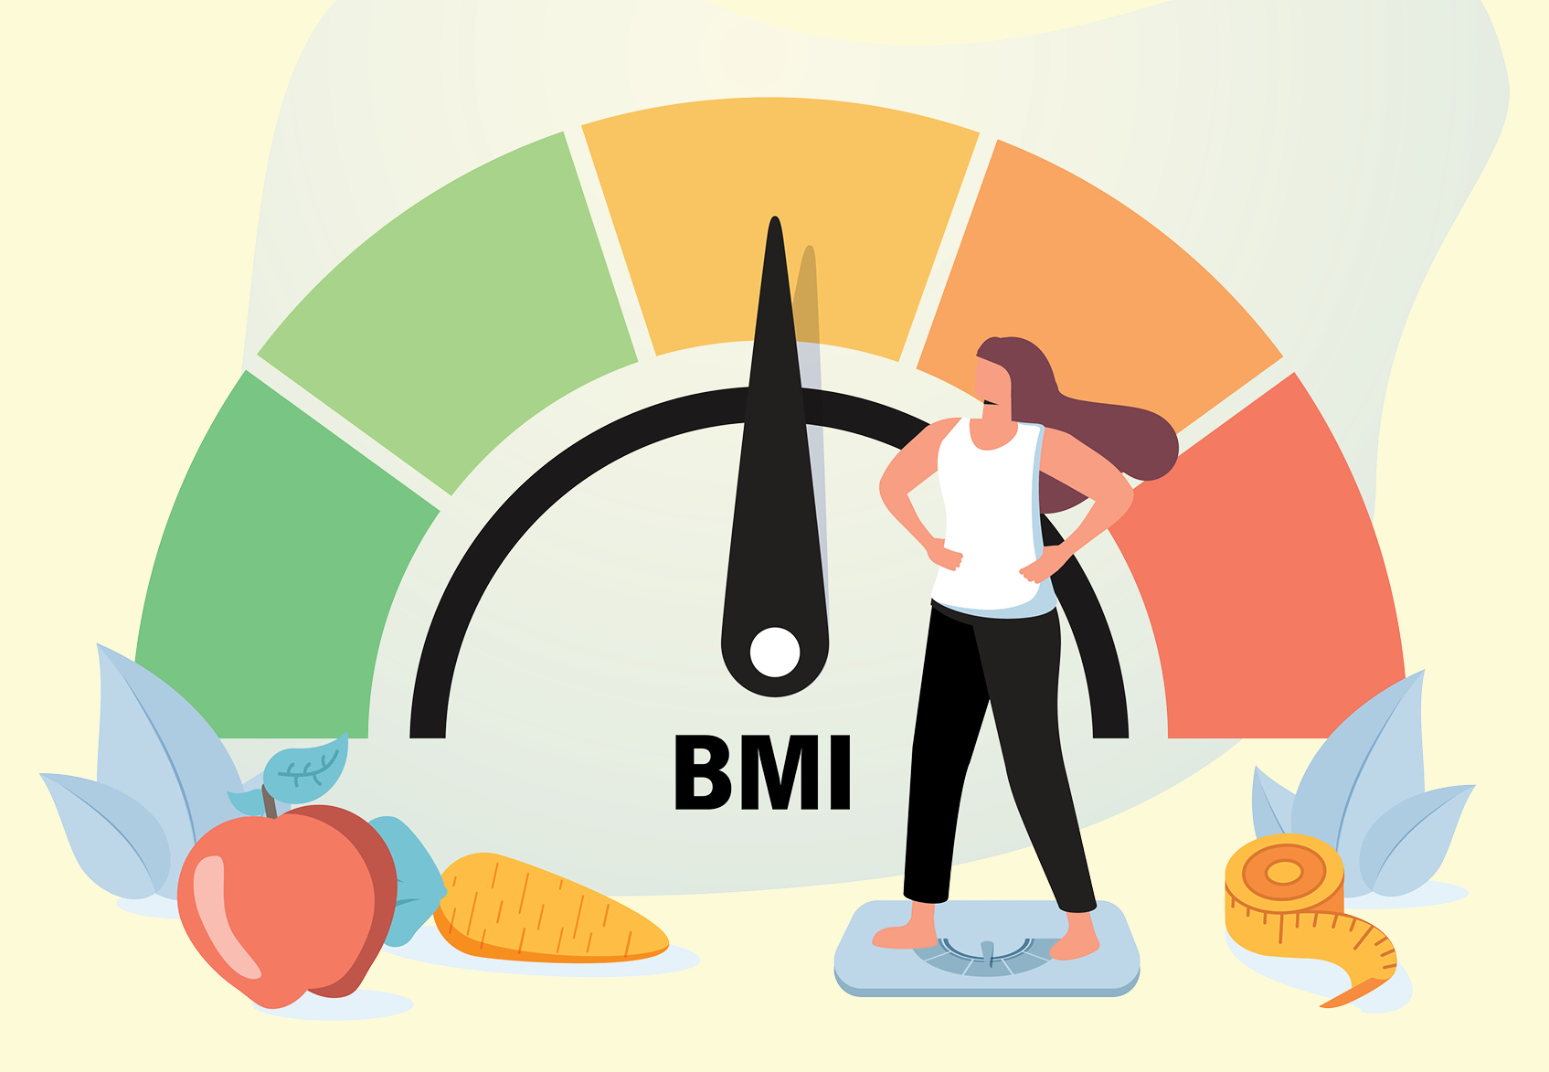
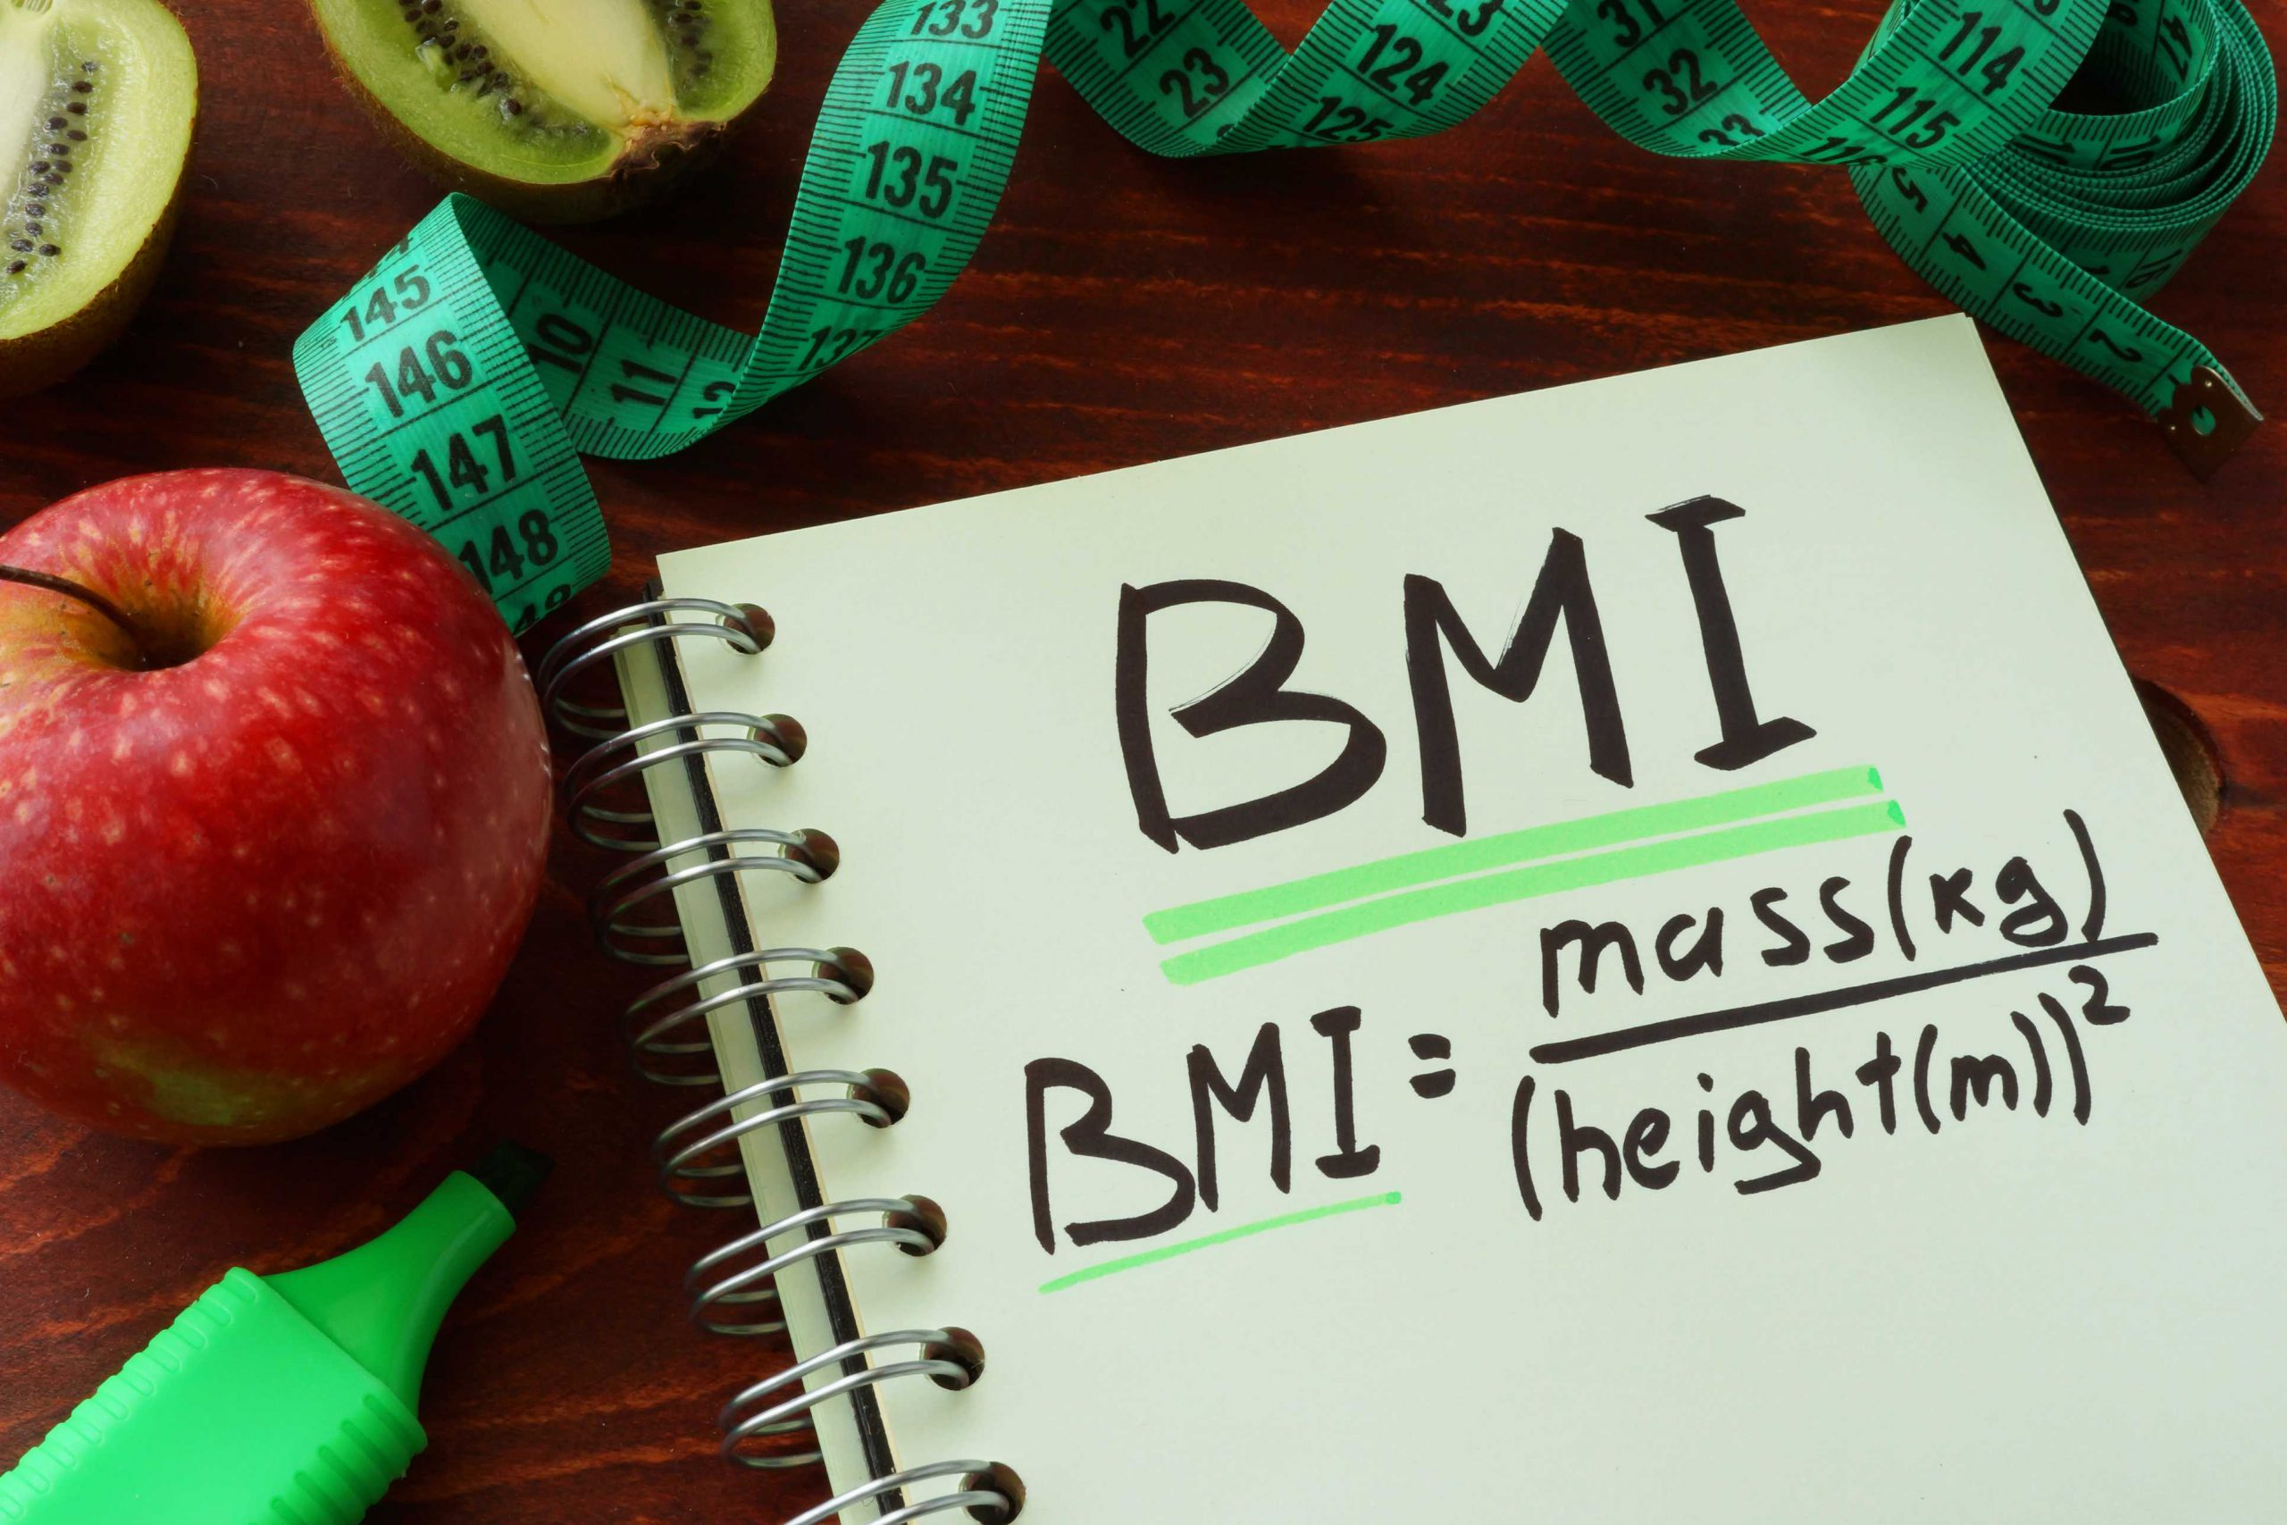
Introduction
Body Mass Index (BMI)
The body mass index (BMI) is a measure that uses your height and weight to work out if your weight is healthy.
The BMI calculation divides an adult’s weight in kilograms by their height in metres squared. For example, A BMI of 25 means 25kg/m2.
Formula: weight (kg) / [height (m)]^2
BMI ranges
For most adults, an ideal BMI is in the 18.5 to 24.9 range.
For children and young people aged 2 to 18, the BMI calculation takes into account age and gender as well as height and weight.

Slide 4
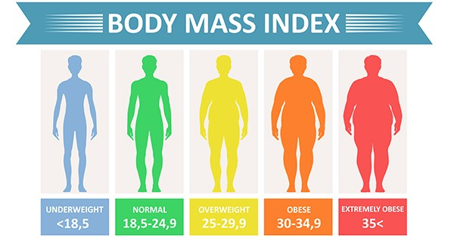
Body Mass Index
If your BMI is:
below 18.5 — you’re in the underweight range
between 18.5 and 24.9 — you’re in the healthy weight range
between 25 and 29.9 — you’re in the overweight range
between 30 and 39.9 — you’re in the obese range

Slide 5
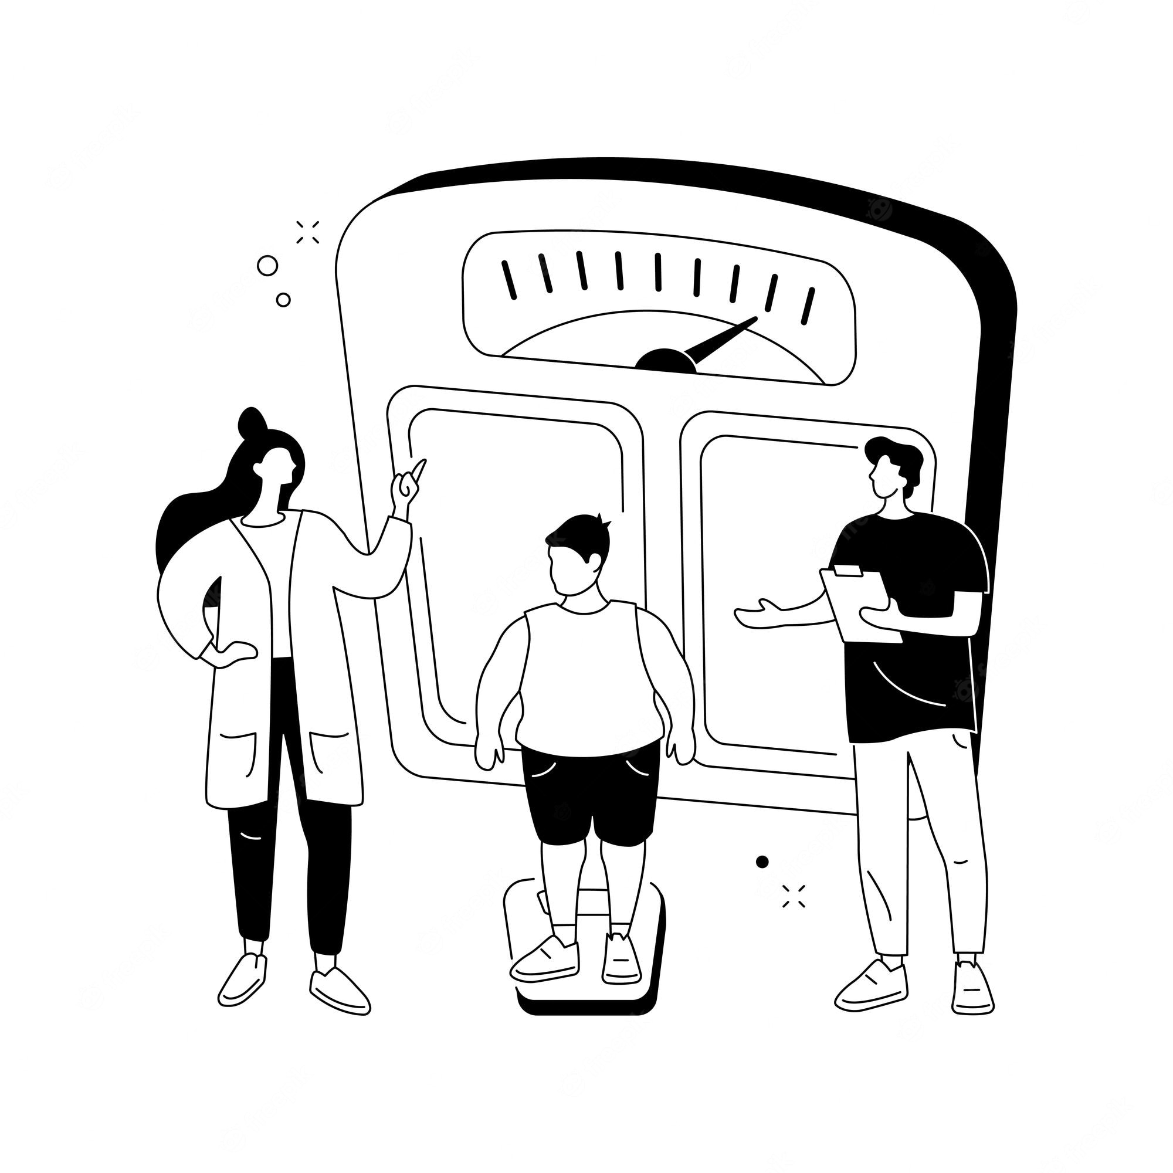
Problem Statement
To perform the weight category prediction of a person given height, weight, and gender. Starting from the data in our possession, classify which type of BMI a person belongs to.
The dataset it uses can be found on Kaggle and contains: Body Mass Index, Weight and Gender of 500 people, where Height and Weight are randomly generated and Body Mass Index is calculated with the BMI formula.

Slide 6
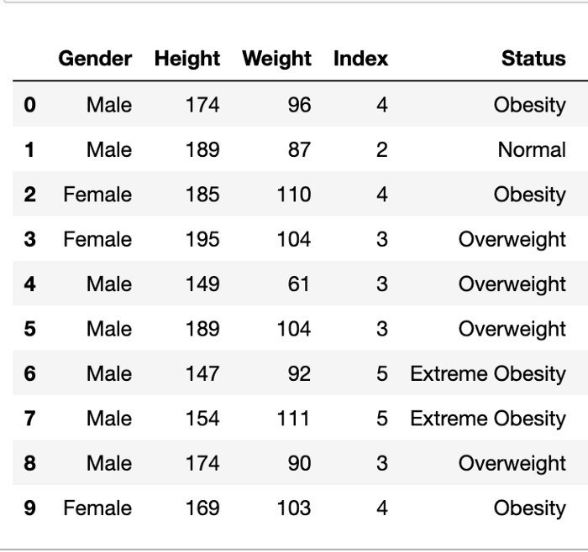
Data
To the original dataset I added the Status column, which shows the BMI category compared to the values in the Index column which are: 0= Extremely weak: BMI<16
1=Weak: 16<BMI<18.5
2=Normal: 18.5<BMI<24.9
3= Overweight:25<BMI<29.9
4=Obesity:30<BMI 34.9
5= Extreme obesity: BMI>35

Slide 7
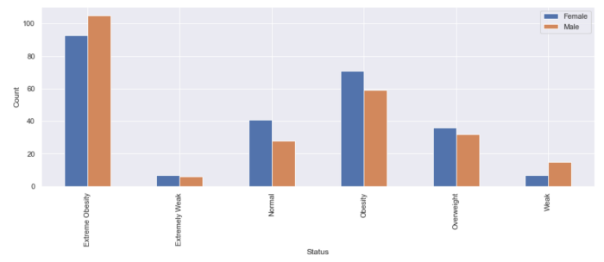
In this way, the analysis and visualization of the data is easier to understand.

Slide 8
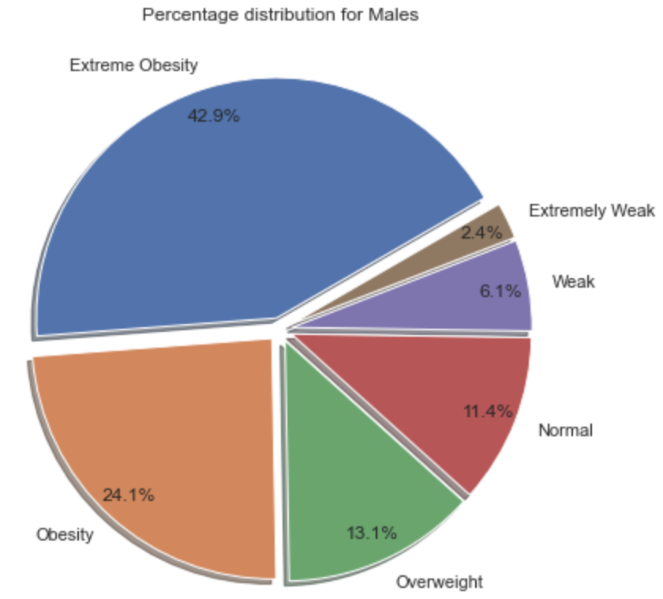
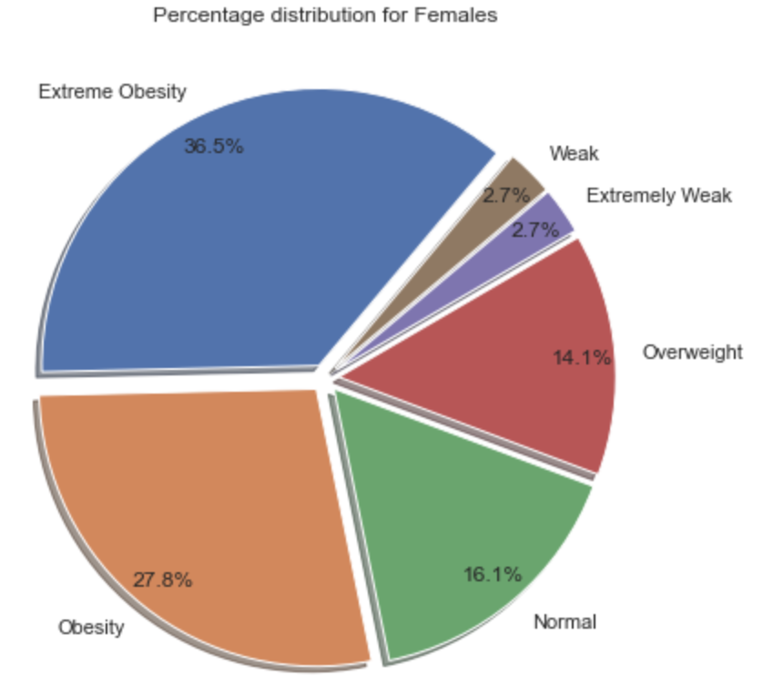
Percentage Distribution for Male and Female
Analysing the available data, in the distribution of people by Status according to Gender we can see that Males are more Extreme obese than females, while we have a greater presence of Females for the Status Obesity and Normal and Females are more Overweight than males.

Slide 9
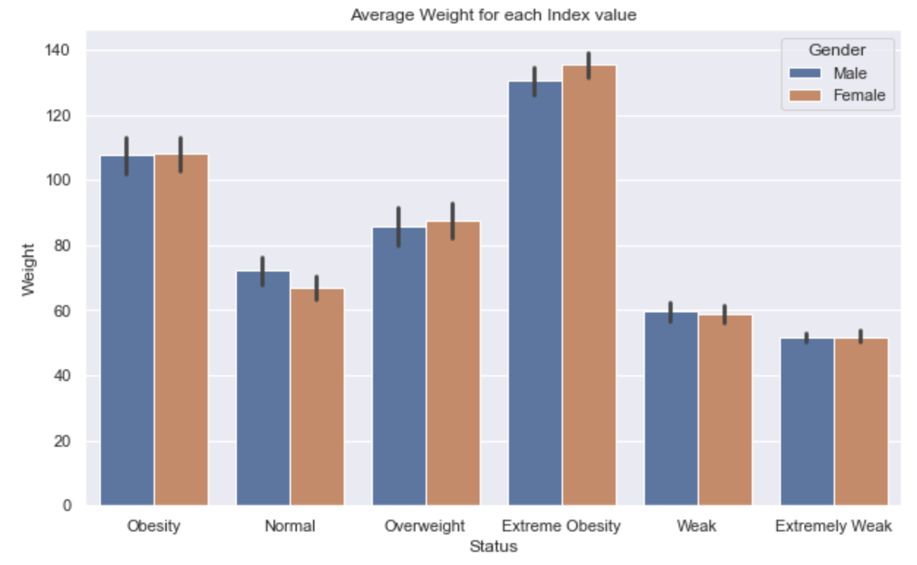
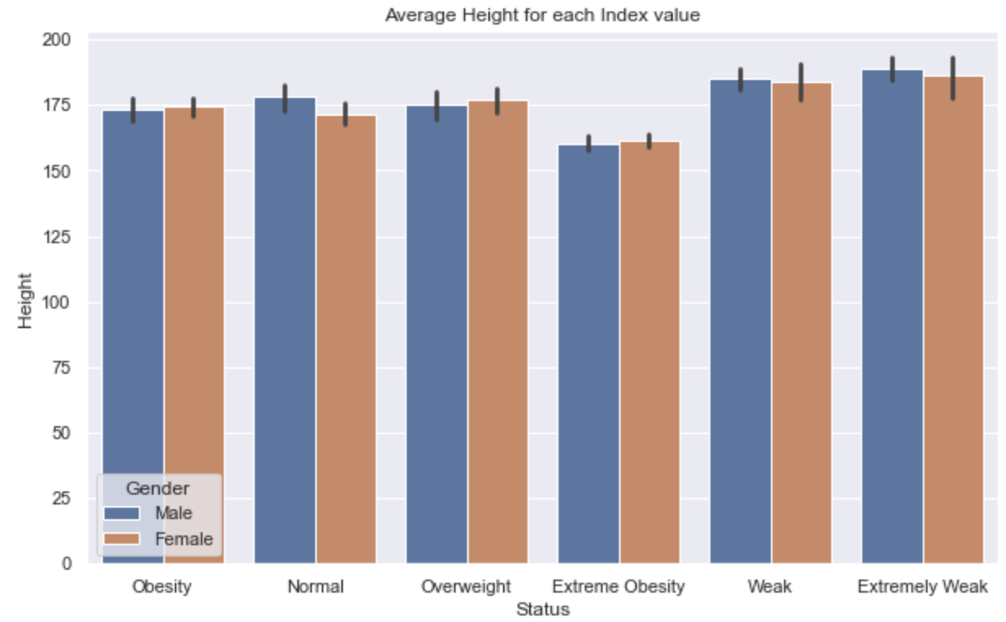
In the pictures below we can see the bar plot of the Status trend by Weight and Height.

Slide 10

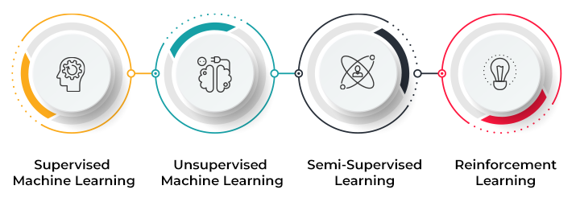
Machine Learning
Machine learning (ML) is a type of artificial intelligence (AI) that allows software applications to become more accurate at predicting outcomes without being explicitly programmed to do so. Machine learning algorithms use historical data as input to predict new output values.
Different types of machine learning
Classical machine learning is often categorized by how an algorithm learns to become more accurate in its predictions.
There are Four basic approaches :

Slide 11
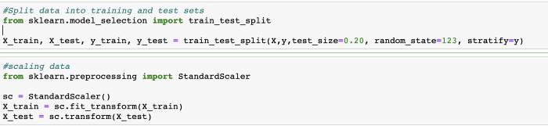
For making our predictive model we will need to proceed with certain steps:
Assign our data instances and target value (X and y columns).
Considering the original dataset, we take the Index column as the ‘target’ variable y, while the remaining columns will be our X ‘predictors’. Furthermore assign to Gender column arbitrary numbers such as 1 to Female and 0 to Male (similar to a Boolean/Truth value) to differentiate them.
Feature scaling and Split data into training and test.
In many machine learning algorithms, to bring all features in the same standing, we need to do scaling so that one significant number doesn’t impact the model just because of their large magnitude.
first step I split data into training and test sets, and after, with Standard Scaler technique that assumes that the data is normally distributed within each feature and scales it so that the distribution is centred around 0, with a standard deviation of 1.

Slide 12
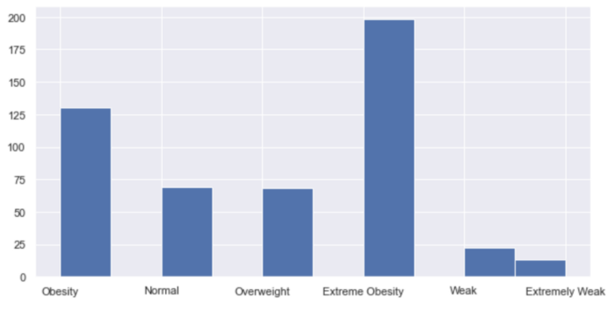
Before training the model, we must take into account that our classes, on which we will apply the classification algorithms, are unbalanced.

Slide 13

Classification algorithms
Training Models
In this study, using our training set I trained 5 supervised machine learning classification algorithms, we have to do a multiclass classification:
Logistic Regression Multinomial
Random Forest for Multiclass
Gradient boosting classifiers
Support Vector Machine for multiclass classification
Neural Networks with TensorFlow

Slide 14
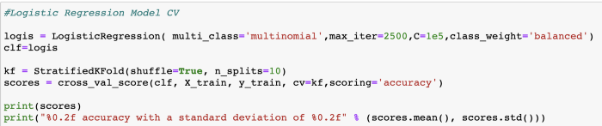
Logistic Regression Multinomial
It is a classification method that generalizes logistic regression to multiclass problems, i.e. with more than two possible discrete outcomes.
That is, it is a model that is used to predict the probabilities of the different possible outcomes of a categorically distributed dependent variable, given a set of independent variables.

Slide 15
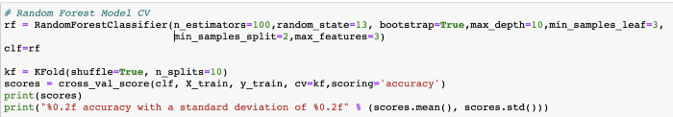
Random Forest for Multiclass
It was chosen in this study because it provides the highest prediction rate in healthcare datasets compared to the other classification algorithms.
Random Forest use averaging to improve the predictive accuracy and control over-fitting and can handle a large number of features, and is helpful for estimating which of your variables are important in the underlying data being modeled.

Slide 16
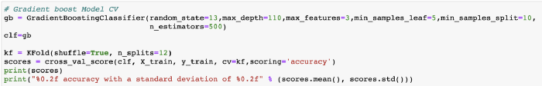
Gradient boosting classifiers
These are a group of machine learning algorithms that combine many weak learning models together to create a strong predictive model and can handle multiclass problems directly.
Decision trees are usually used when doing gradient boosting.

Slide 17
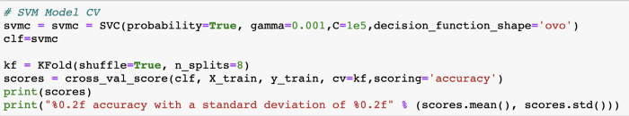
Support Vector Machine for multiclass classification:
SVM is a supervised machine learning technique that is widely used in pattern recognition and classification problems.
In Python the multiclass support is handled according to a one-vs-one scheme where each classifier separates points of two different classes and comprising all one-vs-one classifiers leads to a multiclass classifier.

Slide 18
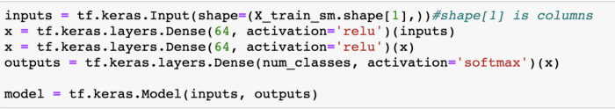
Neural Networks with TensorFlow:
Artificial neural networks (ANNs) were inspired by information processing and distributed communication nodes in biological systems. ANNs have various differences from biological brains. Specifically, neural networks tend to be static and symbolic, while the biological brain of most living organisms is dynamic (plastic) and analog.
For our study we build a multilayer perceptron with 2 hidden layers. Our architecture this time will have neurons = X_Train_sm in input layer, 64 neurons in 2 hidden layer and 6 in the output layer. We will also changing the activation function to ReLu and will be using adam optimizer. Our model will look like this :

Slide 19
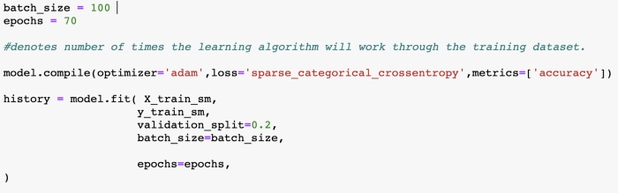
Compile Method receives three arguments
An optimizer. We use Adam an optimization algorithm that can be used instead of the classical stochastic gradient descent procedure to update network weights iterative based in training data. A loss function. This is the objective that the model will try to minimize. A list of metrics. For any classification problem you will want to set this to metrics=[‘accuracy’].

Slide 20
Test and evaluate the model
I trained each model and fine-tuning their hyper-parameters using the grid search, each model has a series of hyper-parameters that must be set, it is not advisable to use the default values, they often give not good results. After I evaluated and compared their performance via their Accuracy.
The confusion matrix detects the count of TP (true positive), TN (true negative), FP (false positive), FN (false negative) in the predictions of a classifier.
From Confusion matrix we can derive the Accuracy which is given by the sum of the corrected predictions divided by the total number of predictions and the diagonal is the counting of TP so the higher these values the better the predictive ability of the model.
Accuracy = TP+TN/TP+FP+FN+TN

Slide 21
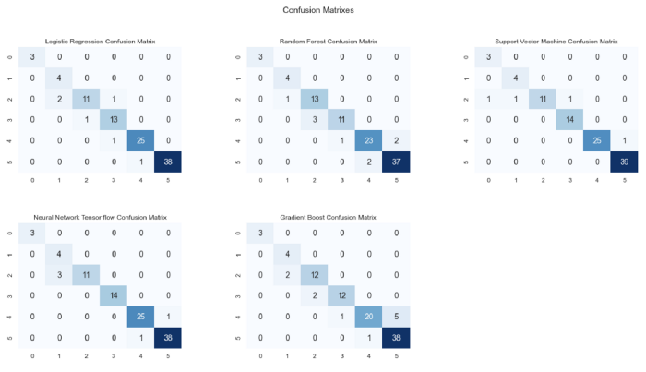
Confusion Matrixes
We can see that, the TP or FP that we find from the confusion matrix are all between classes that are close to each other, i.e.: there is no misclassification between Extremely Obese and Normal which are far apart.

Slide 22

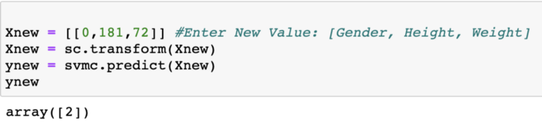
Testing
To test the models with my own data:
Gender=0 is Male Height=181 Weight=72
Index 2 stands for Normal: Wow! it works and I have a good BMI ❤

Slide 23
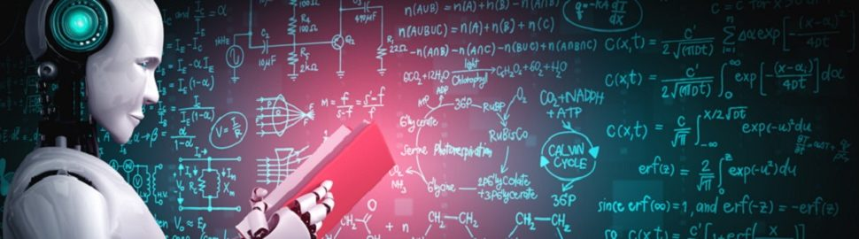
Conclusions
Certainly, future studies should be done on a larger data collection, containing more features such as blood data, lean mass index and fat mass index or the number of steps taken during the day by people, to prevent overweight-related diseases.

Slide 24
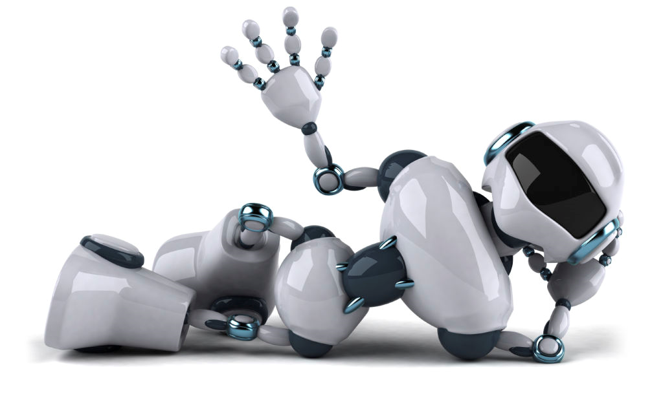
THANK YOU

